Slide 1
Biblical Integration
Revelation & The Rest of the Bible
OIF
Pastor Hugo

Slide 2
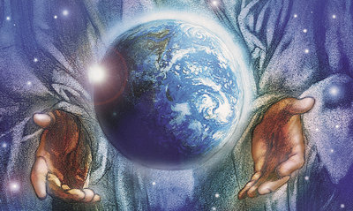
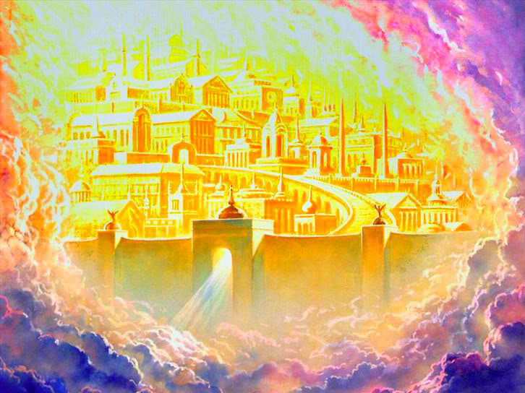
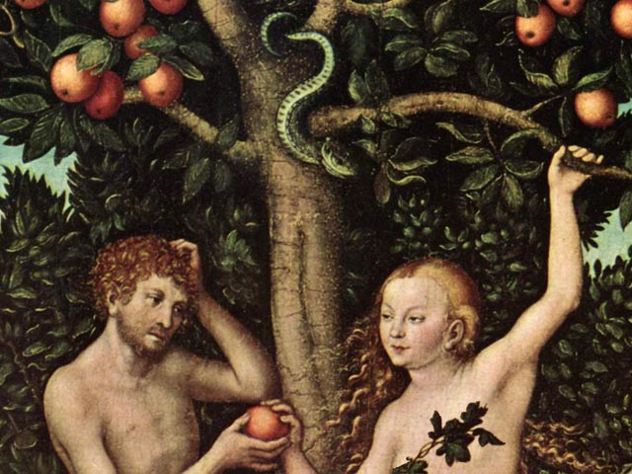
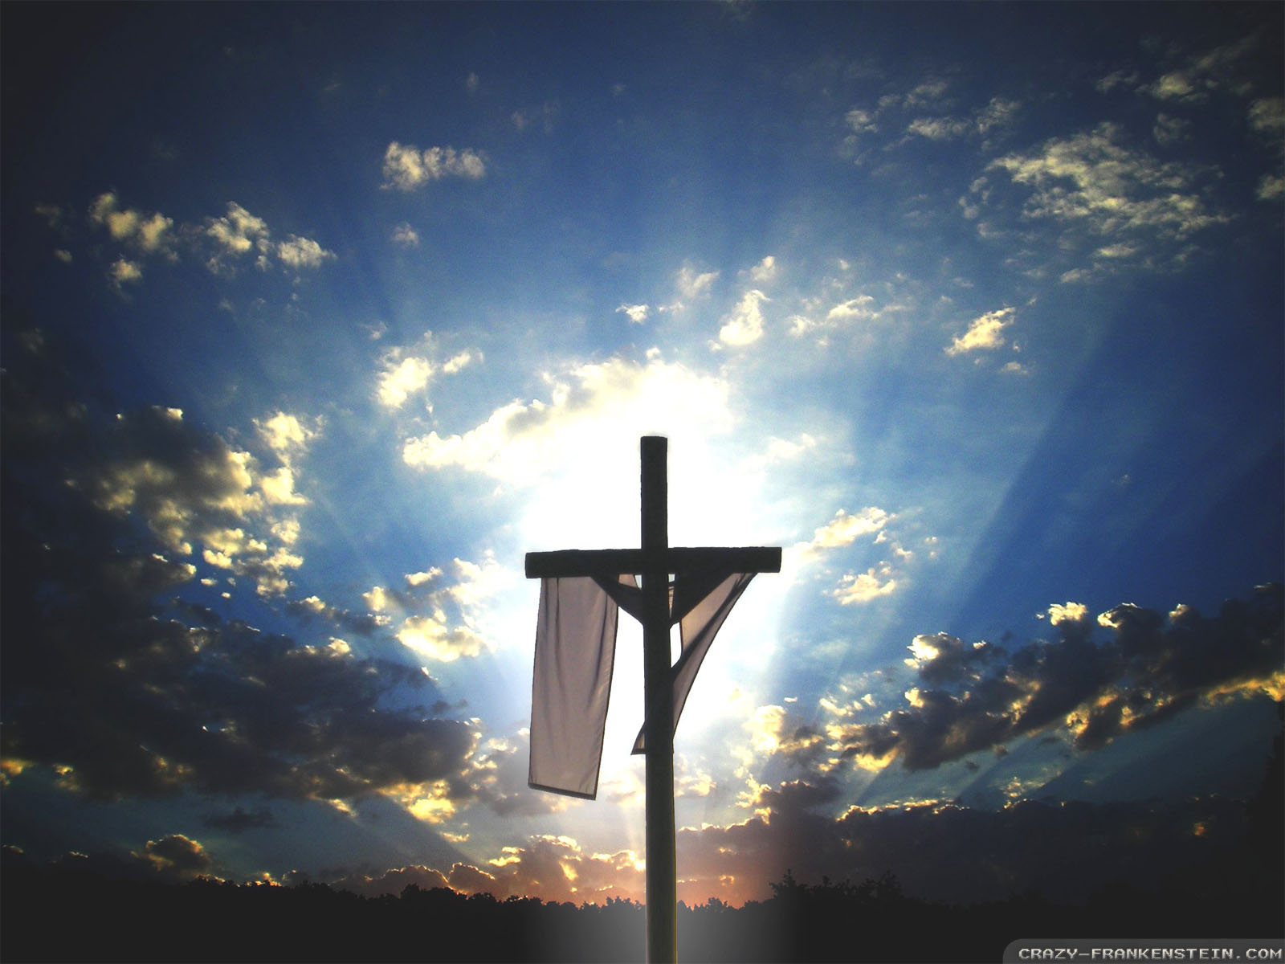
1. The Entire Bible is One Grand Story of God’s Redemptive Plan
1. Creation
4. Consummation
2. Fall
3. Redemption

Slide 3
1. The Entire Bible is One Grand Story of God’s Redemptive Plan
1 Peter 1:20
He was foreknown before the foundation of the world but was made manifest in the last times for the sake of you.
Galatians 4:4-5
But when the fullness of time had come, God sent forth his Son, born of woman, born under the law, to redeem those who were under the law, so that we might receive adoption as sons.
Luke 24:27, 44
And beginning with Moses and all the Prophets, he interpreted to them in all the Scriptures the things concerning himself.
Then he said to them, “These are my words that I spoke to you while I was still with you, that everything written about me in the Law of Moses and the Prophets and the Psalms must be fulfilled.”

Slide 4
2. Some Key OT & NT Passages Correlating with Revelation
1. Take some time to compare Gen. 1-3 & Rev. 20-22

Slide 5
2. Some Key OT & NT Passages Correlating with Revelation
1. Take some time to compare Gen. 1-3 & Rev. 20-22
Genesis Revelation
Creation New creation
God with man and woman God with His people
Garden Garden
Satan deceiving Satan condemned
Tree of life guarded off Tree of life for all to eat
Genesis as the first book of the Bible and Revelation as the last book of the Bible act like two “bookends” that start and finish the story of God’s redemption plan.

Slide 6
2. Some Key OT & NT Passages Correlating with Revelation
2. Daniel & Revelation
Daniel 7:1-8
In the first year of Belshazzar king of Babylon, Daniel saw a dream and visions of his head as he lay in his bed. Then he wrote down the dream and told the sum of the matter. Daniel declared, “I saw in my vision by night, and behold, the four winds of heaven were stirring up the great sea. And four great beasts came up out of the sea, different from one another. The first was like a lion and had eagles' wings. Then as I looked its wings were plucked off, and it was lifted up from the ground and made to stand on two feet like a man, and the mind of a man was given to it. And behold, another beast, a second one, like a bear. It was raised up on one side. It had three ribs in its mouth between its teeth; and it was told, ‘Arise, devour much flesh.’ After this I looked, and behold, another, like a leopard, with four wings of a bird on its back. And the beast had four heads, and dominion was given to it. After this I saw in the

Slide 7
2. Some Key OT & NT Passages Correlating with Revelation
2. Daniel & Revelation
Daniel 7:1-8
night visions, and behold, a fourth beast, terrifying and dreadful and exceedingly strong. It had great iron teeth; it devoured and broke in pieces and stamped what was left with its feet. It was different from all the beasts that were before it, and it had ten horns. I considered the horns, and behold, there came up among them another horn, a little one, before which three of the first horns were plucked up by the roots. And behold, in this horn were eyes like the eyes of a man, and a mouth speaking great things.

Slide 8
2. Some Key OT & NT Passages Correlating with Revelation
2. Daniel & Revelation
Revelation 13:1-10
And I saw a beast rising out of the sea, with ten horns and seven heads, with ten diadems on its horns and blasphemous names on its heads. And the beast that I saw was like a leopard; its feet were like a bear's, and its mouth was like a lion's mouth. And to it the dragon gave his power and his throne and great authority. One of its heads seemed to have a mortal wound, but its mortal wound was healed, and the whole earth marveled as they followed the beast. And they worshiped the dragon, for he had given his authority to the beast, and they worshiped the beast, saying, “Who is like the beast, and who can fight against it?” And the beast was given a mouth uttering haughty and blasphemous words, and it was allowed to exercise authority for forty-two months. It opened its mouth to utter blasphemies against God, blaspheming his name and his dwelling, that is, those who dwell in heaven. Also it was

Slide 9
2. Some Key OT & NT Passages Correlating with Revelation
2. Daniel & Revelation
Revelation 13:1-10
allowed to make war on the saints and to conquer them. And authority was given it over every tribe and people and language and nation, and all who dwell on earth will worship it, everyone whose name has not been written before the foundation of the world in the book of life of the Lamb who was slain. If anyone has an ear, let him hear: If anyone is to be taken captive, to captivity he goes; if anyone is to be slain with the sword, with the sword must he be slain. Here is a call for the endurance and faith of the saints.
God gave Daniel visions of the future things to come, the coming and passing of kingdoms, leading to the anti-Christ, which John also was given similar vision in Revelation.

Slide 10
2. Some Key OT & NT Passages Correlating with Revelation
2. Ezekiel & Revelation
Ezekiel 47:6-12
And he said to me, “Son of man, have you seen this?” Then he led me back to the bank of the river. As I went back, I saw on the bank of the river very many trees on the one side and on the other. And he said to me, “This water flows toward the eastern region and goes down into the Arabah, and enters the sea; when the water flows into the sea, the water will become fresh. And wherever the river goes, every living creature that swarms will live, and there will be very many fish. For this water goes there, that the waters of the sea may become fresh; so everything will live where the river goes… And on the banks, on both sides of the river, there will grow all kinds of trees for food. Their leaves will not wither, nor their fruit fail, but they will bear fresh fruit every month, because the water for them flows from the sanctuary. Their fruit will be for food, and their leaves for healing.”

Slide 11
2. Some Key OT & NT Passages Correlating with Revelation
2. Ezekiel & Revelation
Revelation 22:1-3
Then the angel showed me the river of the water of life, bright as crystal, flowing from the throne of God and of the Lamb through the middle of the street of the city; also, on either side of the river, the tree of life with its twelve kinds of fruit, yielding its fruit each month. The leaves of the tree were for the healing of the nations. No longer will there be anything accursed, but the throne of God and of the Lamb will be in it, and his servants will worship him.
God gave Ezekiel similar images as He gave John, with visions about the future and final state of new heaven and new earth.

Slide 12
2. Some Key OT & NT Passages Correlating with Revelation
2. Ezekiel & Revelation
Ezekiel 48:35
The circumference of the city shall be 18,000 cubits. And the name of the city from that time on shall be, “The Lord Is There.”
Revelation 21:3, 22-23
And I heard a loud voice from the throne saying, “Behold, the dwelling place of God is with man. He will dwell with them, and they will be his people, and God himself will be with them as their God”... And I saw no temple in the city, for its temple is the Lord God the Almighty and the Lamb. And the city has no need of sun or moon to shine on it, for the glory of God gives it light, and its lamp is the Lamb.

Slide 13
2. Some Key OT & NT Passages Correlating with Revelation
3. Isaiah & Revelation
Isaiah 65:17-25
“For behold, I create new heavens and a new earth, and the former things shall not be remembered or come into mind. But be glad and rejoice forever in that which I create; for behold, I create Jerusalem to be a joy, and her people to be a gladness. I will rejoice in Jerusalem and be glad in my people; no more shall be heard in it the sound of weeping and the cry of distress. No more shall there be in it an infant who lives but a few days, or an old man who does not fill out his days, for the young man shall die a hundred years old, and the sinner a hundred years old shall be accursed. They shall build houses and inhabit them; they shall plant vineyards and eat their fruit. They shall not build and another inhabit; they shall not plant and another eat; for like the days of a tree shall the days of my people be, and my chosen shall long enjoy the work of their hands. They shall not labor in vain or bear children for calamity, for

Slide 14
2. Some Key OT & NT Passages Correlating with Revelation
3. Isaiah & Revelation
Isaiah 65:17-25
they shall be the offspring of the blessed of the Lord, and their descendants with them. Before they call I will answer; while they are yet speaking I will hear. The wolf and the lamb shall graze together; the lion shall eat straw like the ox, and dust shall be the serpent's food. They shall not hurt or destroy in all my holy mountain,” says the Lord.

Slide 15
2. Some Key OT & NT Passages Correlating with Revelation
3. Isaiah & Revelation
Revelation 21:1-5
Then I saw a new heaven and a new earth, for the first heaven and the first earth had passed away, and the sea was no more. And I saw the holy city, new Jerusalem, coming down out of heaven from God, prepared as a bride adorned for her husband. And I heard a loud voice from the throne saying, “Behold, the dwelling place[a] of God is with man. He will dwell with them, and they will be his people, and God himself will be with them as their God. He will wipe away every tear from their eyes, and death shall be no more, neither shall there be mourning, nor crying, nor pain anymore, for the former things have passed away.” And he who was seated on the throne said, “Behold, I am making all things new.”
In a similar way, God also gave the prophet Isaiah vision of the future new heaven and new earth.

Slide 16
2. Some Key OT & NT Passages Correlating with Revelation
3. Isaiah & Revelation
Isaiah 11:1-10
There shall come forth a shoot from the stump of Jesse, and a branch from his roots shall bear fruit. And the Spirit of the Lord shall rest upon him, the Spirit of wisdom and understanding, the Spirit of counsel and might, the Spirit of knowledge and the fear of the Lord. And his delight shall be in the fear of the Lord.
He shall not judge by what his eyes see, or decide disputes by what his ears hear, but with righteousness he shall judge the poor, and decide with equity for the meek of the earth; and he shall strike the earth with the rod of his mouth, and with the breath of his lips he shall kill the wicked. Righteousness shall be the belt of his waist, and faithfulness the belt of his loins. The wolf shall dwell with the lamb, and the leopard shall lie down with the young goat, and the calf and the lion and the fattened calf together; and a little child shall lead them. The cow and the bear shall graze; their young shall

Slide 17
2. Some Key OT & NT Passages Correlating with Revelation
3. Isaiah & Revelation
Isaiah 11:1-10
lie down together; and the lion shall eat straw like the ox. The nursing child shall play over the hole of the cobra, and the weaned child shall put his hand on the adder's den. They shall not hurt or destroy in all my holy mountain; for the earth shall be full of the knowledge of the Lord as the waters cover the sea. In that day the root of Jesse, who shall stand as a signal for the peoples—of him shall the nations inquire, and his resting place shall be glorious.
Revelation 22:16
“I, Jesus, have sent my angel to testify to you about these things for the churches. I am the root and the descendant of David, the bright morning star.”
Jesus is portrayed as the branch and the root of David in both!

Slide 18
2. Some Key OT & NT Passages Correlating with Revelation
4. The Apostle Paul & Revelation
1Cor. 15:51-56
Behold! I tell you a mystery. We shall not all sleep, but we shall all be changed, in a moment, in the twinkling of an eye, at the last trumpet. For the trumpet will sound, and the dead will be raised imperishable, and we shall be changed. For this perishable body must put on the imperishable, and this mortal body must put on immortality. When the perishable puts on the imperishable, and the mortal puts on immortality, then shall come to pass the saying that is written: “Death is swallowed up in victory.” “O death, where is your victory? O death, where is your sting?” The sting of death is sin, and the power of sin is the law. But thanks be to God, who gives us the victory through our Lord Jesus Christ.

Slide 19
2. Some Key OT & NT Passages Correlating with Revelation
4. The Apostle Paul & Revelation
1Thess. 4:13-18
But we do not want you to be uninformed, brothers, about those who are asleep, that you may not grieve as others do who have no hope. For since we believe that Jesus died and rose again, even so, through Jesus, God will bring with him those who have fallen asleep. For this we declare to you by a word from the Lord,[d] that we who are alive, who are left until the coming of the Lord, will not precede those who have fallen asleep. For the Lord himself will descend from heaven with a cry of command, with the voice of an archangel, and with the sound of the trumpet of God. And the dead in Christ will rise first. Then we who are alive, who are left, will be caught up together with them in the clouds to meet the Lord in the air, and so we will always be with the Lord. Therefore encourage one another with these words.

Slide 20
2. Some Key OT & NT Passages Correlating with Revelation
3. Isaiah & Revelation
Revelation 20:4-6
Then I saw thrones, and seated on them were those to whom the authority to judge was committed. Also I saw the souls of those who had been beheaded for the testimony of Jesus and for the word of God, and those who had not worshiped the beast or its image and had not received its mark on their foreheads or their hands. They came to life and reigned with Christ for a thousand years. The rest of the dead did not come to life until the thousand years were ended. This is the first resurrection. Blessed and holy is the one who shares in the first resurrection! Over such the second death has no power, but they will be priests of God and of Christ, and they will reign with him for a thousand years.
Inspired by the Holy Spirit, the Apostle Paul wrote of the future resurrected state of Christ followers, which relates to Rev. 20.

Slide 21
3. How Then Shall We Live?
2 Peter 3:8-13
But do not overlook this one fact, beloved, that with the Lord one day is as a thousand years, and a thousand years as one day. The Lord is not slow to fulfill his promise as some count slowness, but is patient toward you, not wishing that any should perish, but that all should reach repentance. But the day of the Lord will come like a thief, and then the heavens will pass away with a roar, and the heavenly bodies will be burned up and dissolved, and the earth and the works that are done on it will be exposed. Since all these things are thus to be dissolved, what sort of people ought you to be in lives of holiness and godliness, waiting for and hastening the coming of the day of God, because of which the heavens will be set on fire and dissolved, and the heavenly bodies will melt as they burn! But according to his promise we are waiting for new heavens and a new earth in which righteousness dwells.

Slide 22
Discussion Questions
What do you look forward to the most of Christ’s return and the promise of the new heaven and new earth?
How does knowing that the entire Bible from Genesis to Revelation is one single story of God’s redemption plan help you to live as a follower of Jesus?
How important is it believe that Jesus will for sure return as He promised? Why? Do you believe this and look forward eagerly to it? Why or why not?

