Slide 1
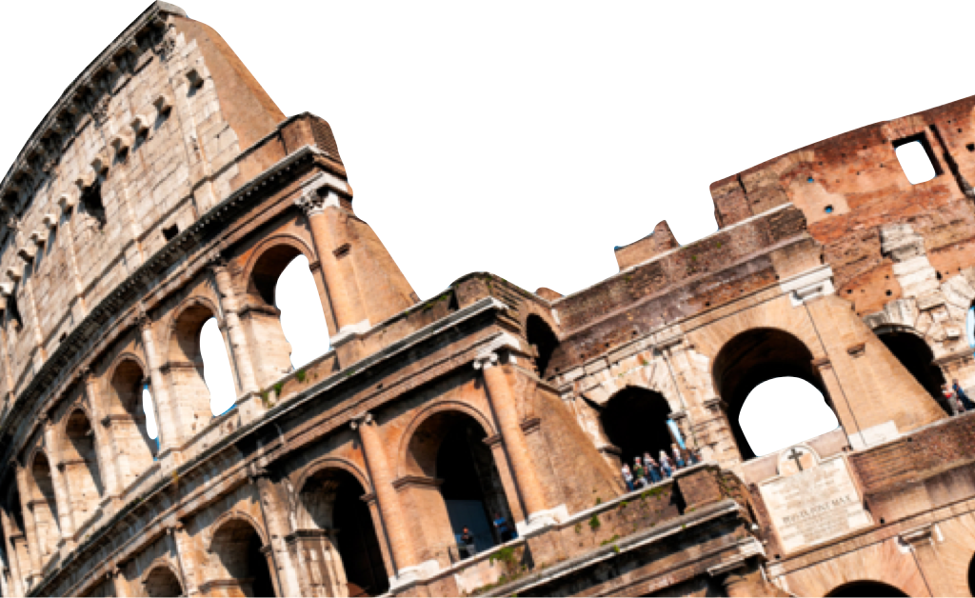
ROMANS
A New Life, A New Beginning
Romans 6:1-14
Laying a solid foundation
Calvin Chiang

Slide 2
Previously on Romans…
So far we have learned a lot of principles about sin, judgment, justification and about sin coming into the world through one man Adam and grace coming as a free gift through Christ.
After justification there is a sanctification process.

Slide 3
Icebreaker Question
If a person was to wait until their death bed to try to repent and accept Christ as their saviour, do you think God will still accept them? Why or why not?

Slide 4
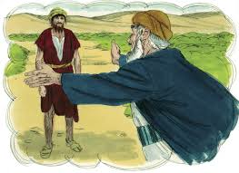
Common Misunderstanding of Salvation by Grace (Rom 1:1-2)
What shall we say then? Are we to continue in sin so that grace may increase? 2 May it never be! How shall we who died to sin still live in it?
A common misunderstanding would be to say that since we are justified by grace, we can continue to sin and just exploit the grace of God. Should we go on to live an irresponsible lifestyle? Should we to continue in sin so that grace may increase? **
Paul’s response is a resounding “never”. We died to sin (past tense), how then can we live in it any longer?
Freedom that we have in Christ is not a freedom to do anything we want to do, but to have the freedom to make good choices.**
Notes:
*We are taught that freedom is to do whatever, whenever we like. But actually that’s not true. That actually leads to destruction. Example of the Prodigal Son. Prodigal Son left home and spent all of his money on wild living thinking that was freedom. However, true freedom was received when he came home, was welcomed by his father, family. True freedom is to have choices but more importantly to be able to make good choices and good decisions.

Slide 5
Our New Position in Christ (Rom 6:3-11)
3 Or do you not know that all of us who have been baptized into Christ Jesus have been baptized into His death? 4 Therefore we have been buried with Him through baptism into death, so that as Christ was raised from the dead through the glory of the Father, so we too might walk in newness of life. 5 For if we have become united with Him in the likeness of His death, certainly we shall also be in the likeness of His resurrection, 6 knowing this, that our old self was crucified with Him, in order that our body of sin might be done away with, so that we would no longer be slaves to sin; 7 for he who has died is freed from sin.
8 Now if we have died with Christ, we believe that we shall also live with Him, 9 knowing that Christ, having been raised from the dead, is never to die again; death no longer is master over Him. 10 For the death that He died, He died to sin once for all; but the life that He lives, He lives to God. 11 Even so consider yourselves to be dead to sin, but alive to God in Christ Jesus.
Our position in Christ is illustrated by baptism by immersion in water. **
“Therefore if anyone is in Christ, he is a new creature, the old things passed away; behold new things have come. (2 Cor.5:17)
“Newness of Life” (v.4) means extraordinary, astonishing, and supernatural.
Notes:
*When a believer descends into the water and the water envelops him, it is like being buried when you die. It symbolizes the death and burial of the old way of life. Coming up out of the water symbolizes resurrection to new life with Christ.
*Example of dipping a piece of garment into dye and changing the identity of the cloth. White shirt into red dye. You no longer call it a white shirt anymore. “Therefore if anyone is in Christ, he is a new creature, the old things passed away; behold new things have come (2 Cor. 5:17).
“Newness of Life” (v.4) means extraordinary, astonishing, and supernatural.

Slide 6
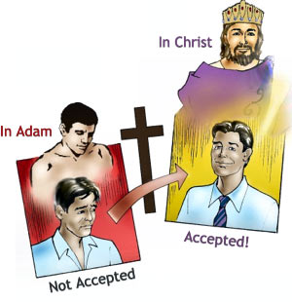
Our New Position in Christ Continued…
“Dead to Sin”. Sin doesn’t go away. Our old self was crucified and we have been made clean through the work of Christ, but we still have a sinful residue (our body of sin/flesh) that will not leave us until we receive a glorified body. We are no longer enslaved to sin, but rather we are released from sin. **
Alive in Christ (v. 8-11)
Paul reminds us that we are to live a resurrected life in the present. Even though we might be discouraged or feel defeated. We are to place our confidence in the God’s Word and His promises.
Consider yourselves to be dead to sin but alive to God in Christ Jesus (v.11). Consider is an accounting term which means to carefully add up figures and then act on that knowledge. It is in present tense and means that it is a command that needs to be obeyed again and again, throughout your life, several times a day.
Notes:
*God might take away certain sins in your life once you become a believer, but leaves others.
*Example of washing out old milk jugs.
*Example of the mortician and the cadavers.

Slide 7
Power to Live the Christian Life (Rom 6:12-14)
12 Therefore do not let sin reign in your mortal body so that you obey its lusts, 13 and do not go on presenting the members of your body to sin as instruments of unrighteousness; but present yourselves to God as those alive from the dead, and your members as instruments of righteousness to God. 14 For sin shall not be master over you, for you are not under law but under grace.
Although you died to sin, sin has not died and wants to reign in your body (v.12). The moment that you believed in Christ, you were given everything you need to become mature and make good decisions.
However, in order for this to happen you mist work hard to realize this goal. You will need to do everything in your power to put flesh to death. Know your particular area of sin struggle and deal with it by cutting off the source. **
12 Not that I have already obtained it or have already become perfect, but I press on so that I may lay hold of that for which also I was laid hold of by Christ Jesus. 13 Brethren, I do not regard myself as having laid hold of it yet; but one thing I do: forgetting what lies behind and reaching forward to what lies ahead, 14 I press on toward the goal for the prize of the upward call of God in Christ Jesus. (Phil 3:12-14)
16 But I say, walk by the Spirit, and you will not carry out the desire of the flesh. 17 For the flesh sets its desire against the Spirit, and the Spirit against the flesh; for these are in opposition to one another, so that you may not do the things that you please. (Gal. 5:16-17)
Notes:
*Anger, Lust, Compulsion, Competitive Nature. Important to know your particular area of sin struggle and deal with it by cutting off the source.

Slide 8
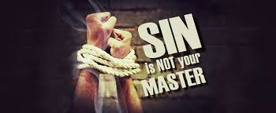
Power to Live the Christian Life Continued…
Present yourselves to God (v.13). This is not a one time decision to give everything that we are to the Lord (mind, body, plans, and goals), but rather a daily decision to put the agenda of Christ above everything else in life.
Instrument (a weapon that fights God’s enemies)**
Sin is no longer your master (v.14). Sin does not have the dominion over the person who is united to Christ. Paul again reminds us that we are not under law but rather grace. This grace gives us a sure position in Christ and gives us the power to live out the victorious Christian life.
Notes:
*We become a weapon (instrument) that fights God’s enemies. Lord I give you my eyes (not look at anything inappropriate), I give you my tongue (not say anything negative), I give you my feet (not going to go anywhere where you disapprove of). I give you my home, my salary, my future, my spouse, my children.

Slide 9
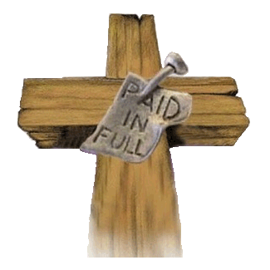
Conclusion
We are crucified with Christ and resurrected to a new life. The 3 step process that helps us to get there are 1) to know your identity in Christ, 2) to consider yourself dead to sin, alive in Christ Jesus and 3) to present yourself fully to God.

Slide 10
Discussion Questions
In what area of my life am I more prone to let sin reign? How can I be sure that victory can be claimed in this area?
What assurance and encouragement is Paul giving us in our struggle against sin?
Does baptism help us to be more holy? What is the point of being baptized?

