Slide 1
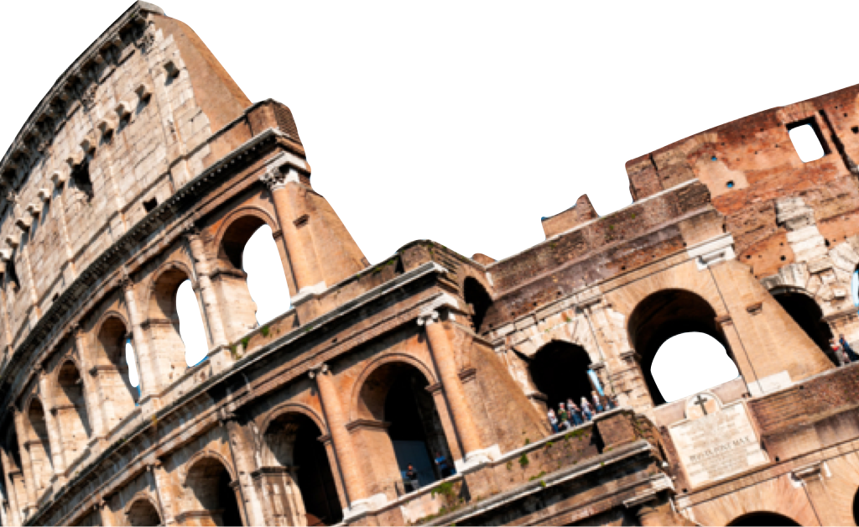
ROMANS
God’s Righteousness Revealed
Romans 3:21-26
Laying a solid foundation
Calvin Chiang

Slide 2
Previously on Romans….
From Roman 1:18-3:20, we have been looking at the issue of human sin and responsibility. These verses paint a very dark picture between God and His created beings.
Finally today’s verses bring about sunshine and hope for that darkness. The full light will come in Chapters 6-8, but the light will start to come through today.

Slide 3
The Righteousness of God (Romans 3:21-26)
21 But now apart from the Law the righteousness of God has been manifested, being witnessed by the Law and the Prophets, 22 even the righteousness of God through faith in Jesus Christ for all those who believe; for there is no distinction; 23 for all have sinned and fall short of the glory of God, 24 being justified as a gift by His grace through the redemption which is in Christ Jesus; 25 whom God displayed publicly as a propitiation in His blood through faith. This was to demonstrate His righteousness, because in the forbearance of God He passed over the sins previously committed; 26 for the demonstration, I say, of His righteousness at the present time, so that He would be just and the justifier of the one who has faith in Jesus.
Because of our sins, God wants to offer us a solution.
The way God freely and graciously justifies any sinner, is not by the works of the Law, but by faith in Christ’s atoning sacrifice-a sacrifice which demonstrates God’s justice in dealing with sin.
***Righteousness of God: refers to the status of those who have been declared righteous by God through no merit of their own.

Slide 4
God Made His Righteousness Available: Through Christ
Paul further explains what he means by the “righteousness of God”
It comes through faith, not works (v. 22)
Available not only to Jews only but to all who believe (v. 23).
From the most vial idolater and sexually perverse (1:18-32) to the Jew who claim to be living according to the law of God (2:1-3), there is no distinction since all are sinners and have fallen short of God’s moral and spiritual perfection.
By Grace: All men are justified freely through the redemption that is in Christ Jesus. (v. 24)
Justified Freely: declared righteous and freed from all charges in connection with sin
Redemption: “to buy back”; the idea of Christ’s death –sinners are purchased for God from the enslaving power of sin.
God’s Love for Us
Notes:
God does not require for us to be righteous given the reality of our sin (Romans 3:10-18)

Slide 5
God Made This His Righteousness Available: Without Compromising His Justice (3:25-26)
Christ satisfies God’s wrath against Sin (v.25)
The public event of Christ’s death shows the faithfulness of Christ and how God deals with sins committed beforehand. (v. 25)
God’s justice and justification (action of declaring or making righteous in the sight of God) is satisfied (v. 26)
Through redemption (Christ’s blood = purchase price)
Through propitiation (Himself as sacrifice to appease God’s wrath)
In the OT, it was the blood of a perfect lamb sprinkled in the Holy of Holies
God’s Justice
Notes:
Example of the arc in Indiana Jones and Raiders of the Lost Ark
God has put Christ as “a mean of atonement”, a place where God would meet His people.
Day of Atonement (Yom Kippur) Lev. 16. Jesus is offered and received as our atonement.
Atonement is a “sin offering” The offering pays for the price of sin committed. This is propitiation.
The atonement washes away our sins as though it never existed.
The atonement destroys the power of all forces that oppose God. These include our sin, death, even the law.
This in part is God’s gift. Jesus death covers all sins past, present, and future. Therefore God was able to overlook “sins previously committed. This applies to everyone, Jews, Gentile, no exceptions.

Slide 6
To Sum Up God’s Plan of Making Man Righteous:
All have sinned
Justification
Faith in Jesus
Standing Son-ship (Sanctification: the process of acquiring sanctity: being made or becoming holy)
Notes:
Justification: declared righteous and freed from all charges in connection with sin.

Slide 7
Man’s Boasting Eliminated (Romans 3:27-31)
27 Where then is boasting? It is excluded. By what kind of law? Of works? No, but by a law of faith. 28 For we maintain that a man is justified by faith apart from works of the Law. 29 Or is God the God of Jews only? Is He not the God of Gentiles also? Yes, of Gentiles also, 30 since indeed God who will justify the circumcised by faith and the uncircumcised through faith is one. 31 Do we then nullify the Law through faith? May it never be! On the contrary, we establish the Law.
Boasting is not included in salvation because salvation from beginning to end is a work of God on behalf of sinful, lawless people. (v. 27-28)
Paul repeats that a person is declared righteous by faith apart from works of the law. (v. 29-30)
The Law: Faith upholds the law (v. 31)
Notes:
Question of boasting is mostly addressed to the Jews.
We have done nothing for our salvation. We then have no basis for judging or viewing ourselves in any way superior to anyone else.
The value of the law is that it prepares us for Christ. (Galatians 3:21-26)

Slide 8
Conclusion
God has His own unique way of making us acceptable in His sight
God deals with our sin without condoning it or ignoring it.
God must wipe away our sin so that we suffer no judgment.
God declares us righteous so that we can be acceptable to Him.

Slide 9
Discussion Questions
Let's pretend that you are a judge and someone you love is on trial. Would you be more tempted to compromise your justice or your love? How can God be both just and gracious at the same time?
Can you list some examples in your life that shows that you are currently in the sanctification process?
What does it mean for us in the daily struggle of life to know that God has done everything to make us acceptable to Him and we then have done and can do nothing?

